Slide 2
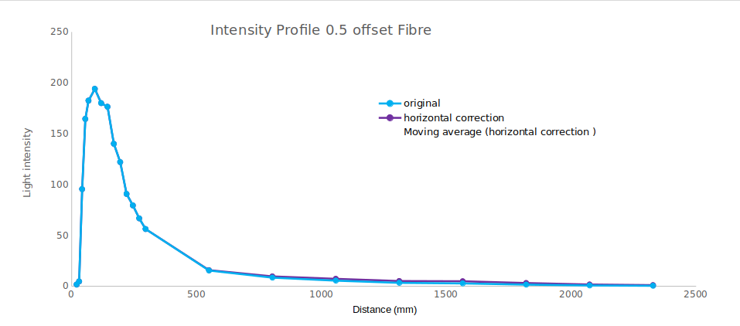
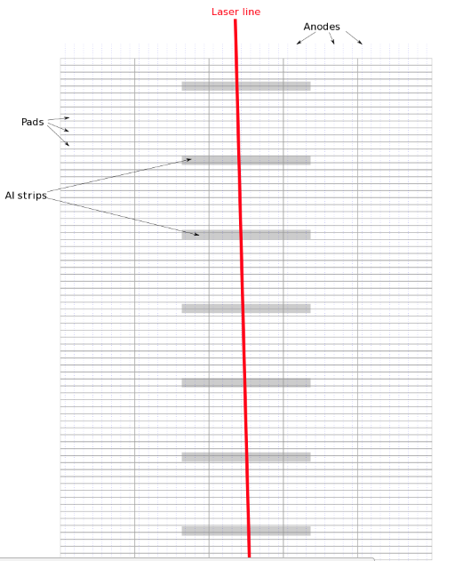
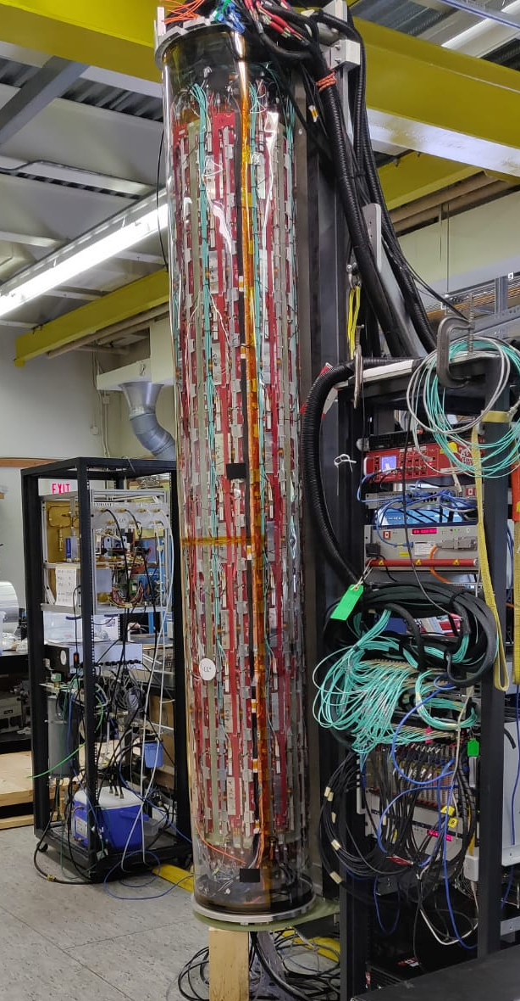
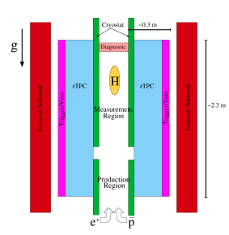
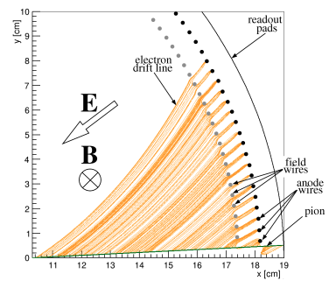
Laser Calibration of the Radial Time Projection Chamber for Measurement of Antimatter Gravity with ALPHA-g
Estifa’a Zaid
Fig [e] Example of an intensity profile of laser beam.
Fig [d] Sketch of laser path within the rTPC².
Fig [a] Photo of the ALPHA-g rTPC
References:
1- Capra, A. (2016). Design of a Radial TPC for Antihydrogen Gravity Measurement with ALPHA-g.
2- Daq.triumf.ca. (2018). ELOG Login. [online] Available at: https://daq.triumf.ca/elog-alphag/alphag/371 [Accessed 17 Jul. 2018].
Fig [c] Cross-sectional view of the rTPC with
the electron drift lines¹.
Fig [b] sketch of ALPHA-g apparatus¹.

